Slide 1



Cartilage tympanoplasty methods: Proposal of a classification
Presentation by…

Slide 2
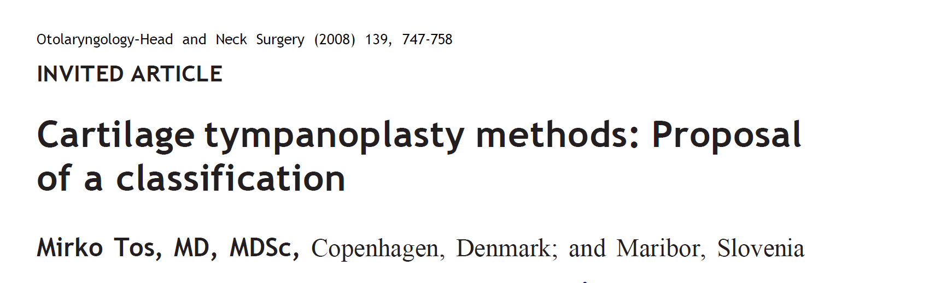

Slide 3
Introduction

Slide 4
The 23 known cartilage tympanoplasty methods to reconstruct the eardrum are classified in six main groups:
Group A: Cartilage tympanoplasty with palisades, stripes, and slices. The eardrum is reconstructed by several, various, full- thickness pieces of cartilage with attached perichondrium on the ear canal side.
Group B: Cartilage tympanoplasty with foils, thin plates, and thick plates, not covered with the perichondrium.
Group C: Tympanoplasty with cartilage-perichondrium composite island grafts. The perichondrium flap suspends or fixates the cartilage.
Group D: Tympanoplasty with special total pars tensa cartilage- perichondrium composite grafts. All three methods are used to close a total perforation, but differ from each.
Group E: Cartilage-perichondrium composite island grafts tympanoplasty for anterior, inferior, and subtotal perforations.
Group F: Special cartilage tympanoplasty methods: The cartilage disc is placed under the perforation, the perichondrium onto the denuded eardrum remnant.

Slide 5
Group A

Slide 6
Group A: Cartilage Tympanoplasty with Palisades, Stripes, and Slices
Characteristic for this group is that the eardrum is reconstructed by several pieces of full-thickness cartilage covered by the perichondrium on the ear canal side.

Slide 7
1. Cartilage palisades in underlay tympanoplasty techniques.
The 0.5- to 3-mm-wide palisades are placed side by side, under the eardrum remnant, usually in a superoinferior direction, but can be placed in anteroposterior or in oblique direction as well.
Heermann placed the anterior palisade (simmering) under the anterior bony annulus.
Its superior end is supported by a piece of cartilage (architrave), placed onto the eminence of the tensor tympani muscle.
Inferiorly and posteriorly the palisades are placed onto the bony annulus.
Another modification is placement of the palisades at the level of the bony annulus a third modification is placement under the bony annulus.
Further modifications are without or with covering of the palisades by the fascia, or the perichondrium.
It will be very interesting to compare the hearing results of the three various placements of the palisades in relation to the bony annulus.

Slide 8
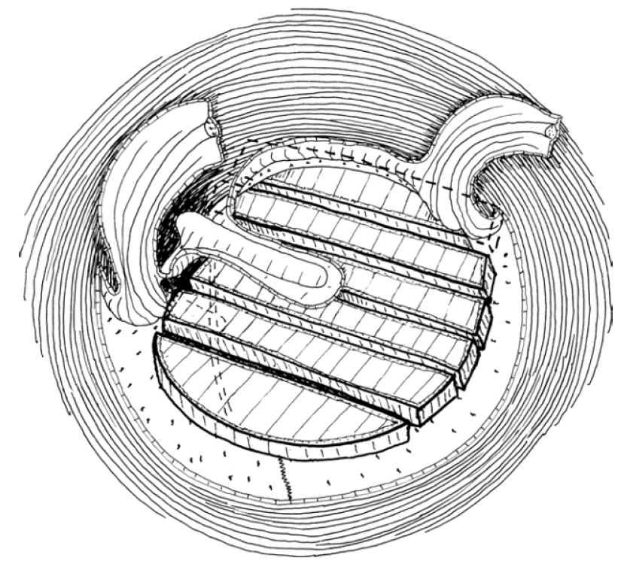
Figure 1
Underlay cartilage palisade tympanoplasty in a total perforation.
A large posterior tympanomeatal flap is elevated.
The anterior palisade is placed under, the other palisades onto, the bony annulus.
At its superior end the architrave is indicated by dashed lines.
Figure 2
The palisades are placed at the level of the bony annulus.
Figure 3
All palisades are placed under the bony annulus.

Slide 9
2. Cartilage palisades in on-lay tympanoplasty techniques
The palisades are placed onto the denuded remnant of the lamina propria and vibrate together with the eardrum remnant.
The ends of the palisades may be shaped and thinned.
There are no clinical reports on this method, which may have some advantages, because no support is needed.
Figure 4
On-lay cartilage palisade tympanoplasty in total perforation. Ear canal skin and eardrum epithelium are elevated and the palisades are placed onto the denuded eardrum remnant.

Slide 10
3. Tympanoplasty with broad cartilage palisades
In the Heermann technique six to eight palisades are needed to close the total perforation.
Using 4- to 5-mm broad palisades , only two or three palisades are needed to cover a total perforation.
The palisades are placed as underlay grafts.
Figure 5
Two broad and a small short palisade cover as underlay grafts the total perforation.

Slide 11
4. Cartilage stripes in underlay tympanoplasty techniques
While the cartilage palisades are cut in a rectangular manner , the cartilage stripes are cut in an oblique manner.
The cartilage palisades are placed close to each other with a small distance , and the cartilage stripes are placed like roof tiles .
The edge of the next stripe is placed onto (or under) the edge of the previous stripe.

Slide 12
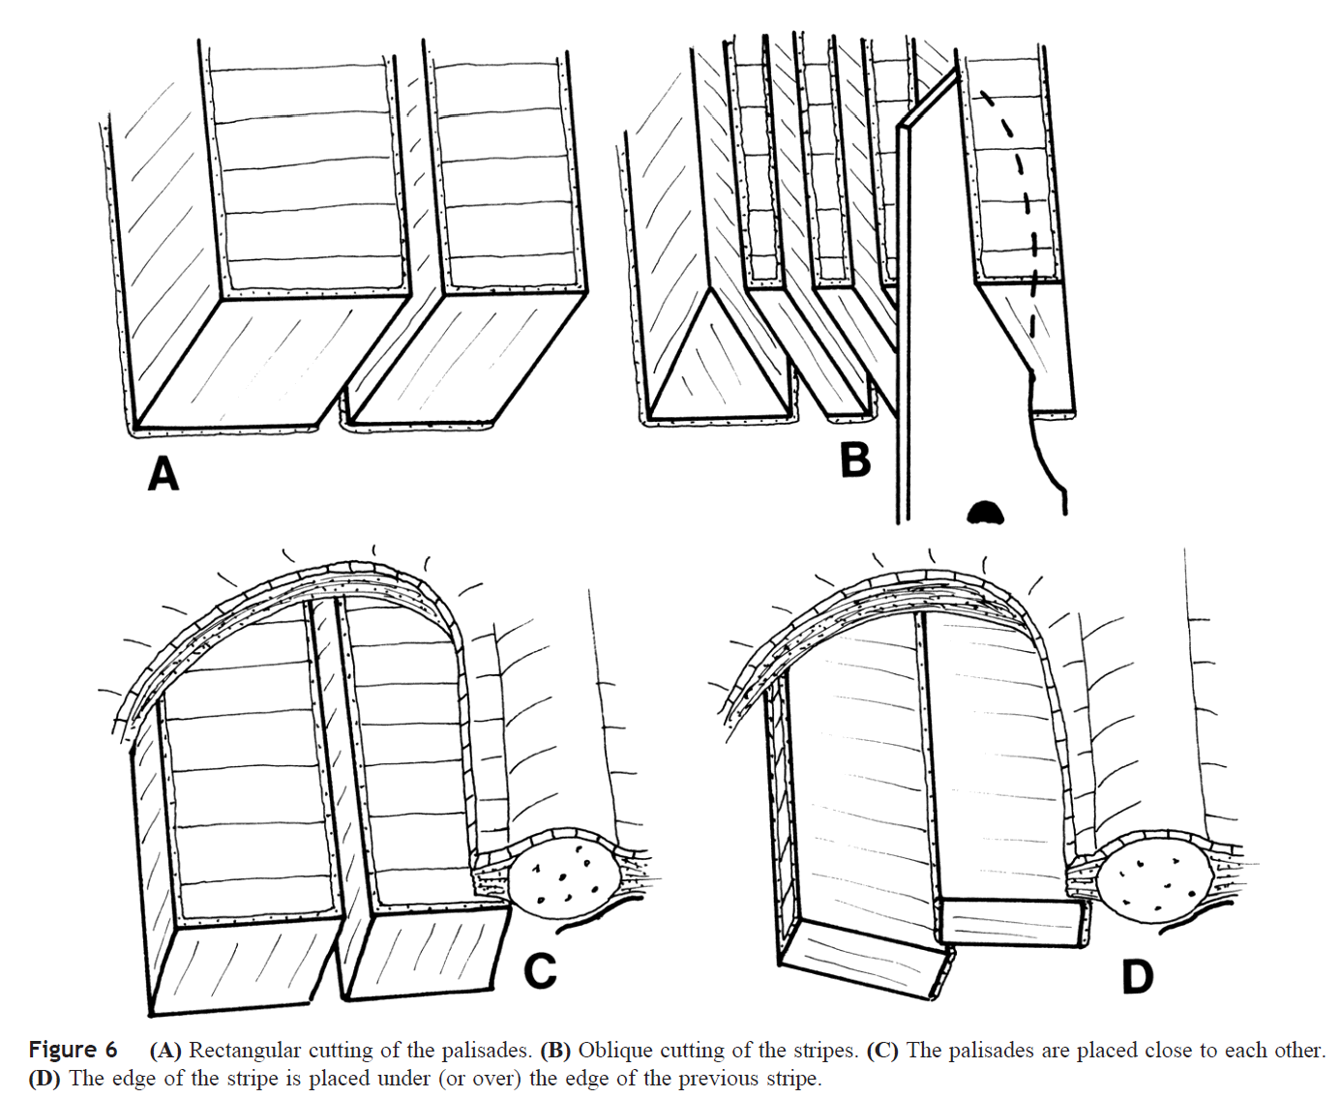
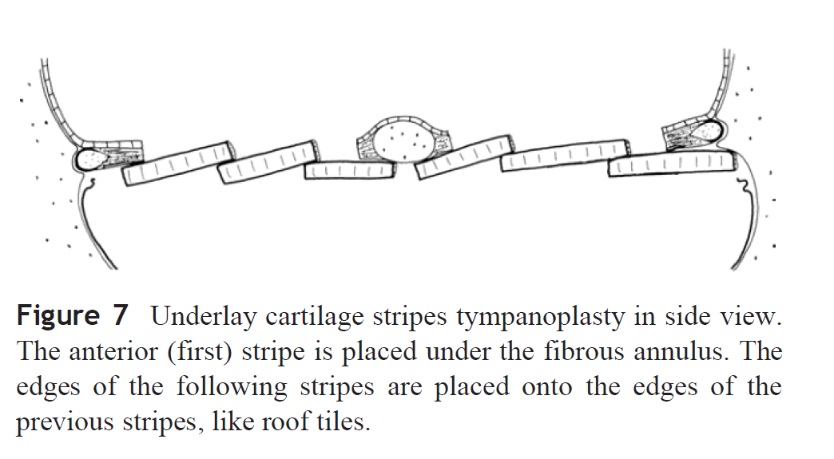

Slide 13
5. Cartilage stripes in on-lay tympanoplasty techniques
First the anterior stripe is placed onto the denuded lamina propria then the edges of the following stripes are placed onto the previous stripes, like the tiles of a roof.

Slide 14
Figure 8
On-lay cartilage stripe tympanoplasty in a total perforation.
The epithelial flaps are elevated and the edges of the total perforation cleansed.
The cartilage stripes are placed onto the denuded lamina propria and onto the edge of the previous stripe.

Slide 15
6. Underlay cartilage slice mosaic tympanoplasty
The full- thickness slices (or pieces) of cartilage, covered on the ear canal side by the perichondrium, are pieced together, like the pieces of a jigsaw puzzle to reconstruct a total perforation.
In contrast to the strict Heermann technique, the Dornhoffer mosaic technique is more “liberal,” allowing slices of various shapes and sizes.
The Dornhoffer mosaic cartilage tympanoplasty can be applied as an on-lay method as well, by placing the cartilage slices onto the denuded lamina propria of the eardrum remnant, but apparently nobody has tried this method yet.

Slide 16
Figure 9
The Dornhoffer mosaic underlay cartilage tympanoplasty in a total perforation.
The slices of various shapes and sizes are pieced together.

Slide 17
Group B

Slide 18
Group B: Cartilage Tympanoplasty with Foils, Thin Plates, and Thick Plates
Characteristic for this group is that the foils, thin plates, or thick plates are not covered with the perichondrium.
The cartilage plates serve as reinforcement of the eardrum or the fascia.
At the end of the surgery the cartilage plates are most often covered with the fascia or the perichondrium, or areolar tissue from the temporal region, resulting in three modifications.

Slide 19
7. Underlay tympanoplasty with cartilage foils and plates
The foils are 0.2 to 0.3 mm thick and are placed under the eardrum remnant, like pieces of a dry fascia.
The foils may overlap each other, like the leaves of a tulip blossom.
Thin cartilage plates, 0.3 to 0.4 mm thick, are placed in the same way.
Figure 10
Underlay cartilage foil tympanoplasty in a total perforation.
After elevation of the tympanomeatal flap, three cartilage foils are placed under the denuded eardrum remnant.
The second foil is overlapping the first and the third foil.

Slide 20
8. On-lay tympanoplasty with cartilage foils and thin plates
The foils are placed onto the denuded lamina propria of the eardrum and may overlap each other.
Figure 11
On-lay cartilage foil tympanoplasty in an inferior perforation.
The epithelium around the perforation is elevated.
The first foil is placed onto the denuded lamina propria and covers the anterior half of the perforation.
The second foil overlaps the first foil and covers the posterior half of the perforation.

Slide 21
9. On-lay tympanoplasty with thick cartilage plates
Thick cartilage plates of 0.5- to 1.0-mm thickness are placed onto the denuded lamina propria and covered with the fascia.
Figure 12
On-lay cartilage tympanoplasty using a cartilage plate without perichondrium.
The epithelium around the total perforation is elevated.
A full-thickness plate with a wedge is placed onto the denuded lamina propria and malleus handle.
The cartilage plate will be covered with fascia.

Slide 22
10. Underlay tympanoplasty with thick cartilage plates
This group is the most variable:
The plates are of various thickness, from 0.5 to 1.0 mm.
The plates are positioned either at the level of the bony annulus or onto the posterior bony annulus.
The cartilage plates are covered either with the fascia or with the areolar tissue from the temporalis muscle region, or they are not covered at all.
In this group, crushed cartilage plates and plates with irradiated homogenous rib cartilage are included.
Figure 13
Side view of the underlay cartilage tympanoplasty, using a full-thickness cartilage plate, placed under the fibrous annulus and under the malleus handle.
A wedge on the upper part of the disc is cut to accommodate the malleus handle.

Slide 23
Group C

Slide 24
Group C: Tympanoplasty with Cartilage- Perichondrium Composite Island Grafts
Characteristic for this group of the oldest composite grafts is a full-thickness cartilage disc, covered on the ear canal site by the perichondrium, which continues as the flap around the disc.
The perichondrium flap suspends or fixates the cartilage disc.

Slide 25
11. Superior cartilage-perichondrium composite island graft tympanoplasty
The attic island graft has to prevent a recurrent attic retraction; it is therefore solidly fixated to the remaining superior attic wall by the perichondrium flap.
The size and the shape of the cartilage is shaped in relation to the bony defect, as visible in the first attic graft of McCleve.
Several different attic grafts are described: with perichondrium flaps on both sides, with several additional coverings of the attic region, either with the fascia, with perichondrium, or with an additional hydroxyapatite plate.
Figure 14
Closure of a large bony defect of the attic, using a large superior cartilage-perichondrium composite graft with large perichondrium flaps, onto the edges of the bony defect.
The superior perichondrium flap is placed onto the ear canal bone, the inferior flap onto the malleus.
The entire attic region is further covered with the fascia.

Slide 26
12. Posterior cartilage-perichondrium composite island graft tympanoplasty.
This graft has a rectangular or oval, full-thickness cartilage disc and a large posterior perichondrium flap, placed onto the posterior ear canal wall.
The small modifications consider the placements of the anterior flap: under the malleus handle and the eardrum, first in to the malleus handle and then under the eardrum, without anterior flap.
Figure 15
Side view of the posterior composite cartilage-perichondrium island graft in closure of a posterior perforation.
The cartilage disc is positioned under the eardrum remnant.
The posterior perichondrium flap is placed onto the ear canal bone, the anterior flap under the malleus handle and anterior part of the eardrum.

Slide 27
13. Superior and posterior cartilage-perichondrium composite island graft tympanoplasty
A large “Pac-Man” graft covers the defect in the attic and the defect of the entire superior part of the tympanic cavity.
Poe and Gadre combine two small, separate cartilage discs covered with one large perichondrium flap.

Slide 28
Figure 16
In case of the attic and the posterosuperior pars tensa retraction (A),
a large composite graft, the “Big Mac” graft (B),
covers the attic region and the superior part of the of the tympanic cavity (C).

Slide 29
14. Total pars tensa cartilage-perichondrium composite island graft tympanoplasty.
The total island graft with a diameter of 7 to 9 mm is used to close a total or subtotal perforation. It has several modifications :
A) the round graft
B) the round graft with different wedges
C) the Dornhoffer graft, consisting of two semicircular discs, connected with the perichondrium
D) the Jahnke graft, with four cartilage belts
E) the “Mercedes- Benz” graft with excision of a vertical strip to the center, and two radial incisions of the cartilage disc, making it conical in shape
F) the wheel- shaped island graft, which split the round disc into four pieces, connected with the perichondrium.

Slide 30
14. Total pars tensa cartilage-perichondrium composite island graft tympanoplasty.
The differences between these techniques may be in placement procedure, conical shape of the grafts, or vibrations of the grafts.
Grafts C through F are easier to be implanted than grafts A and B.
Most total island grafts are implanted in underlay technique.
Nitsche used on-lay placement of the graft.
Thus the on-lay technique may be a reasonable modification as well.

Slide 31
Figure 17
Four examples of the total pars tensa cartilage-perichondrium composite island grafts with the surrounding perichondrium flaps.
The round full-thickness cartilage disc.
With a wedge to accommodate the malleus handle.
The Dornhoffer graft, made by removal of a 2-mm broad, central belt of the cartilage disc, resulting in two semicircular discs connected with the perichondrium.
The Jahnke graft with removal of three small belts of the cartilage.

Slide 32
Figure 18
Side view of the underlay pars tensa total island graft in a total perforation and missing stapes.
The Dornhoffer graft is placed under the fibrous annulus; it covers the head of the titanium prosthesis and the malleus handle.
The perichondrium flaps are placed onto the anterior and posterior ear canal bone.

Slide 33
Group D

Slide 34
Group D: Tympanoplasty with Special Total Pars Tensa Cartilage-Perichondrium Composite Grafts
All three composite grafts are used in closure of a total perforation, but all differ from each other.
The purposes of the grafts differ as well.

Slide 35
15. Annular cartilage-perichondrium composite graft tympanoplasty
The annular graft is a 1.5- to 3-mm broad horse- shoe-shaped cartilage ring covered with the perichondrium, which continues around the cartilage as a peripheral flap.
The purpose of the graft is to maintain the lateral position of the eardrum graft.
The modifications of the annular graft methods are:
placement as on-lay graft onto the eardrum remnant;
removal of the entire fibrous annulus with the eardrum remnant and placement of the annulus graft at the level of the bony annulus, suspended by the perichondrium flap;
underlay placement of the annulus graft.

Slide 36
Figure 19
The on-lay placement of the annular composite graft (dashed lines) onto the denuded eardrum remnant.
The perichondrium flap covers the bone of the ear canal.
The three elevated epithelial flaps will be replaced and will cover the superior ends of the annular graft.
Figure 20
Side view of the on-lay cartilage tympanoplasty with the annular graft.
The annular graft is positioned onto the denuded eardrum remnant (dashed lines); the peripheral perichondrium flap is placed onto the ear canal bone, the central perichondrium under the malleus handle.

Slide 37
16. The “Crowncork” cartilage-perichondrium composite graft tympanoplasty.
This graft has a round cartilage disc, covered on the ear canal side with the perichondrium, with relatively large peripheral flaps covering the ear canal bone in congenital atresia or blounting.

Slide 38
Figure 21
Placement of the crowncork graft in a type 2b congenital atresia with an absent ear canal, malformed ossicles, and a rudimentary pinna.
A wide ear canal is drilled out, exposing the malleus head and incus body.
Figure 22
The round full-thickness cartilage-perichondrium is- land graft is placed onto the incus body and onto the malleus head.
The long perichondrium flaps are folded out, onto the new bony annulus and onto the new ear canal.
The entire ear canal wall will be covered by split-skin grafts.

Slide 39
17. Cartilage shield T-tube tympanoplasty
In cases with total perforation and poor tubal function, a round or a Dornhoffer semicircular pars tensa composite graft with implanted T-tube is placed as an underlay graft.
A tube without flanges can be used as well.
Figure 23
Cartilage shield T-tube tympanoplasty. After elevation of a large tympanomeatal flap and the anterior fibrous annulus and the eardrum remnant, a round island graft, with an inserted T-tube, with two fangs is placed as an underlay graft at the level of the bony annulus and under the malleus handle.
The surrounding perichondrium is folded out and the tympanomeatal flap is replaced.

Slide 40
Group E

Slide 41
Group E: Cartilage-Perichondrium Composite Island Grafts Tympanoplasty for Anterior, Inferior, and Subtotal Perforations
Common for this group are minor or middle-sized composite cartilage-perichondrium island grafts to close anterior, inferior, and subtotal perforations.
The cartilage disc may be of full thickness or three-quarters, one-half, or one-third thickness.
The difference between these four methods is their positions in the tympanic cavity.
In both underlay techniques the graft may be supported by gelfoam.

Slide 42
18. Underlay tympanoplasty techniques with cartilage- perichondrium composite island graft
The perichondrium of the island graft is placed under the perforation and under the denuded lamina propria surrounding the perforation
The thickness of the cartilage disc may vary.

Slide 43
19. In-lay underlay tympanoplasty techniques with composite cartilage-perichondrium composite island graft.
In-lay underlay tympanoplasty techniques with composite cartilage-perichondrium composite island graft.
The cartilage disc is placed from the tympanic cavity into the perforation, the perichondrium flap in placed onto the denuded lamina propria.

Slide 44
20. On-lay tympanoplasty techniques with minor cartilage- perichondrium island graft
After elevation of the epithelium around the perforation, a cartilage disc is placed onto the edge of the denuded lamina propria.
The surrounding perichondrium flap covers the remaining denuded lamina propria.

Slide 45
21. In-lay on-lay tympanoplasty techniques with composite cartilage-perichondrium island graft.
After elevation of the epithelium around the perforation, the full-thickness or the half-thickness cartilage disc is positioned into the perforation.
The surrounding perichondrium flap is placed onto the denuded lamina propria surrounding the perforation.
The on-lay in-lay island graft seems to be a solid graft and we have used it during the last three years.

Slide 46
Figure 24
Side view of the placement of four small or mid-sized composite cartilage-perichondrium island grafts in closure of small or mid-sized anterior or inferior perforations. (A) Underlay cartilage island graft tympanoplasty. The perichondrium with the cartilage is placed under the eardrum and is in contact with the scarified mucosa. The graft is supported by the gelfoam balls.
(B) In-lay underlay cartilage island graft tympanoplasty. The cartilage disc is placed into the cleaned perforation; the surrounding perichondrium flap has contact with the scarified mucosa and is supported with gelfoam balls.
(C) On-lay cartilage island graft tympanoplasty. The epithelium around the perforation is elevated or removed. The cartilage disc and the perichondrium flap are placed onto the denuded lamina propria. The elevated epithelium is replaced.
(D) In-lay on-lay cartilage island graft tympanoplasty. The epithelium around the perforation is elevated. The cartilage disc is placed into the perforation. The perichondrium flap is placed onto the denuded lamina propria around the perforation. Both on-lay methods need no support in the tympanic cavity and are minimally invasive.

Slide 47
Group F

Slide 48
22. In-lay butterfly cartilage tympanoplasty.
A round piece of cartilage covered on both sides with the perichondrium is held with the fingers and cut in the middle parallel to the perichondrium on either side.
The edges of the cartilage curl apart, like the wings of a butterfly.
After removal of the epithelium the Eavey inlay graft is positioned in the perforation, partly as on-lay, partly as on-lay graft, similar to the position of a grommet .
Some surgeons cover the perichondrium with a split skin graft; some do not cover the epithelium.
Figure 25
The butterfly cartilage graft, covered with the perichondrium on both sides, is slightly curled and its one flange is pushed under the denuded edge of the perforation.
The ear canal side of the graft may be covered with a split-skin graft.

Slide 49
23. Composite chondroperichondrial clip tympanoplasty: The triple C technique.
This graft is partly an underlay graft, partly an on-lay graft.
The full-thickness graft, covered with the perichondrium on the ear canal side, has a 2 mm larger diameter than the diameter of the perforation.
A 1-mm belt of the perichondrium is elevated from the cartilage disc as a flap.
After removal, or elevation, of the epithelium around the perforation, the cartilage disc is rotated under the eardrum remnant and the perichondrium flap is pulled out of the perforation and placed onto the denuded eardrum .
Figure 26
Side view of the triple “C” cartilage tympanoplasty, closing an anterior perforation.
The epithelium around the perforation is removed.
A 1-mm broad belt of the perichondrium is elevated from the cartilage graft, being larger than the perforation.
After placing the graft under the edges of the perforation, the perichondrium flap is pulled out of the perforation and placed onto the denuded lamina propria.

Slide 50
THANK YOU
Presentation by …

