Slide 1



Unilateral Sensorineural Hearing Loss in Children: Natural History and Clinical Characteristics
Presentation by Dr. Ahmadzadeh

Slide 2
INTRODUCTION

Slide 3
Congenital unilateral sensorineural hearing loss (SNHL) affects 3–6% of school-age children.
Associated issues: poorer sound localization, worse speech recognition in noise, and delayed language development; diagnosis and treatment are priorities.
Etiology: can be idiopathic or due to genetic mutations, in utero infections, anatomic anomalies, or other causes.
Research landscape: growing but mostly about profound congenital unilateral SNHL; limited data on milder congenital or postnatal unilateral SNHL.
Clinical challenge: unilateral SNHL is less studied than bilateral SNHL, making workups and anticipatory guidance to families more difficult.
Purpose of the study: examine the natural history of congenital and postnatal unilateral SNHL and provide prognostic information for the affected and unaffected ears.

Slide 4
Methods

Slide 5
Study design: Retrospective longitudinal chart review from 2003–2019 at a single academic tertiary pediatric hospital.
Population and inclusion: Medical records with ICD-9/ICD-10 codes screened for ear-specific hearing loss confirmed on at least two audiograms >6 months apart.
Definition of hearing loss: PTA > 15 dB in one ear or one frequency (0.5, 1, 2, or 4 kHz) > 20 dB with normal opposite ear.
Exclusion criteria: Prior normal ear-specific tests (including ABR after NBHS failure), platinum-based chemotherapy, purely conductive loss, or atypical sudden loss presentation.
Onset classification:
  Congenital unilateral SNHL: Failed NBHS.
  Postnatal unilateral SNHL: Passed NBHS.
  Unknown onset: No NBHS result available.

Slide 6
Primary measures:
  Primary outcome: Ear-specific pure tone average (PTA) over time.
  Time points per ear: first audiogram, most recent, and midpoint (if available); all with normal tympanograms and testing at ≥0.5, 1, and 2 kHz (and 4 kHz if present).
  Progression: PTA change > 10 dB (per ASHA test–retest guidelines).
Secondary measures: Race/ethnicity, sex, imaging, and genetic testing.
Analysis tools:
  Nonparametric stats in GraphPad Prism v9.5.1.
  Modeling with R v4.2.1 and VGAM v1.1-8 for frequency-specific audiogram trajectories.
  Logistic regression due to violation of proportional odds with a GLM (Brant test).
Visualization: GraphPad Prism and R ggplot2.

Slide 7
Results

Slide 8
Patient Demographics and CMV Testing
Data set size: Retrieved 1,264 charts; 476 patients included.
Gestational age data: Available for 459 patients (96.4%).
  Premature (<37 weeks): 69 patients (14.5%)
  Full-term: 407 patients
Group comparability: Gestational ages similar between congenital and postnatal groups; average patient born full term.
CMV testing:
  most patients in this study were identified prior to routine CMV testing .
  12 patients had CONFIRMED CMV testing: 7 negative, 5 positive.

Slide 9
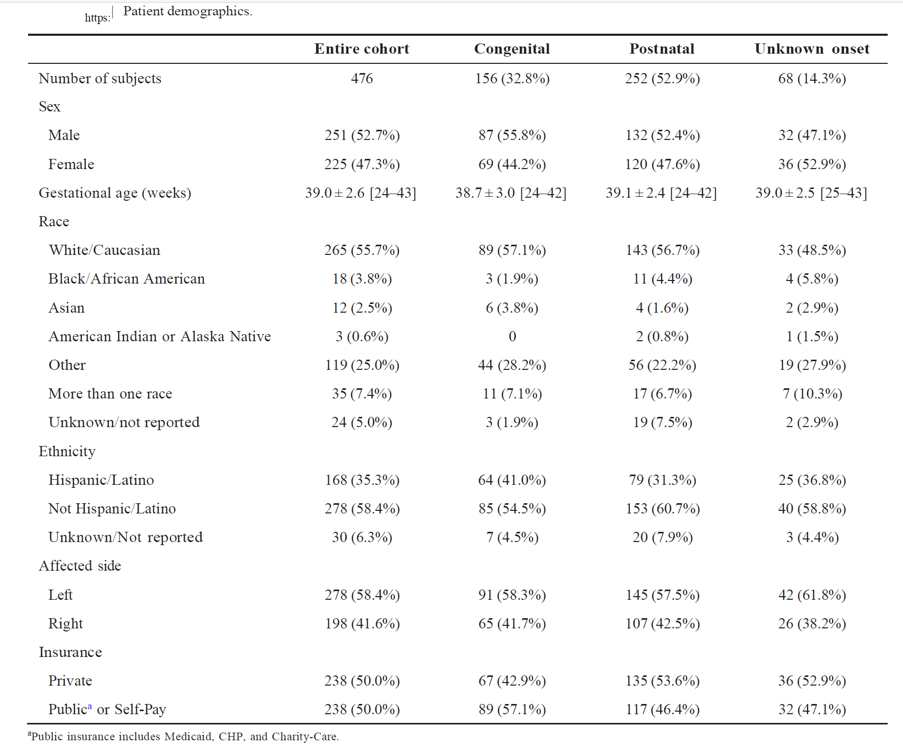

Slide 10
Hearing Outcomes
Study population
  NBHS done in 408/476.
  Groups: congenital (156 failed NBHS), postnatal (252 passed NBHS), unknown (68).
  ABR: 89 congenital; none in others. Avg ABR age: 2 months.
Ages at audiograms and follow-up
  First audiogram: 6.6 ± 3.4 years; Last: 11.2 ± 3.9 years.
  First-audiogram by group: congenital 4.4 ± 2.7; postnatal 7.4 ± 3.2 ; unknown 8.4 ± 3.5.
  Follow-up: 4.6 ± 3.1 years (39.3% ≥ 5 years).
  Group follow-up: congenital 4.8 ± 3.2; postnatal 4.4 ± 2.9.
  Private insurance associated with ~8.1 months longer follow-up.
Affected ear hearing (PTA)
  Initial PTA: 53.8 ± 29.4 dB.
  Change to last audiogram: +3.0 ± 14.5 dB (overall).
  Stability: 82.4% stable; 17.6% progressed >10 dB.
  Congenital vs postnatal at first: 68.7 ± 27.4 dB vs 45.5 ± 27.3 dB .
  Change in PTA: congenital +4.7 ± 22.1; postnatal +0.9 ± 14.5 .

Slide 11
Progressive hearing loss (>10 dB)
  Congenital: 26.3% vs postnatal: 14.3%
  For progressors: average PTA increase 25.5 ± 16.3 dB (overall); 28.1 ± 20.1 (congenital); 23.5 ± 11.6 (postnatal).
  Average Gestational age in progressors: 38.6 ± 3.3 weeks.
  7 progressors also worsened in normal ear (8.3%).
Contralateral ear (normal-hearing) PTA
  First contralateral PTA: 10.6 ± 5.8 dB.
  Change first to last: −1.9 ± 7.4 dB (overall improvement or adaptation to audiogram test).
  Congenital: −3.9 ± 7.3; Postnatal: −1.0 ± 8.1.
  Worsened contralateral PTA >10 dB: 11 patients (2.3%; avg 26.5 ± 19.7 dB).
  Worsening contralateral ear linked to better initial affected-ear hearing (37.7 ± 23.2 dB) vs stable contralateral (54.2 ± 29.4 dB).
  No difference in contralateral worsening between congenital vs postnatal .
Frequency-specific findings
  PTAs rose mid-way, then slightly declined; no clinically significant progression from first to last.
  Higher frequencies associated with greater odds of hearing loss (mild OR 1.53; moderate 1.49; severe 1.29; profound 1.16(
  Time effects: mid-audiogram had lower odds of mild hearing loss only (OR 0.66;). Other time comparisons not consistently significant.
  Last to first: no significant changes in odds of hearing loss.

Slide 12
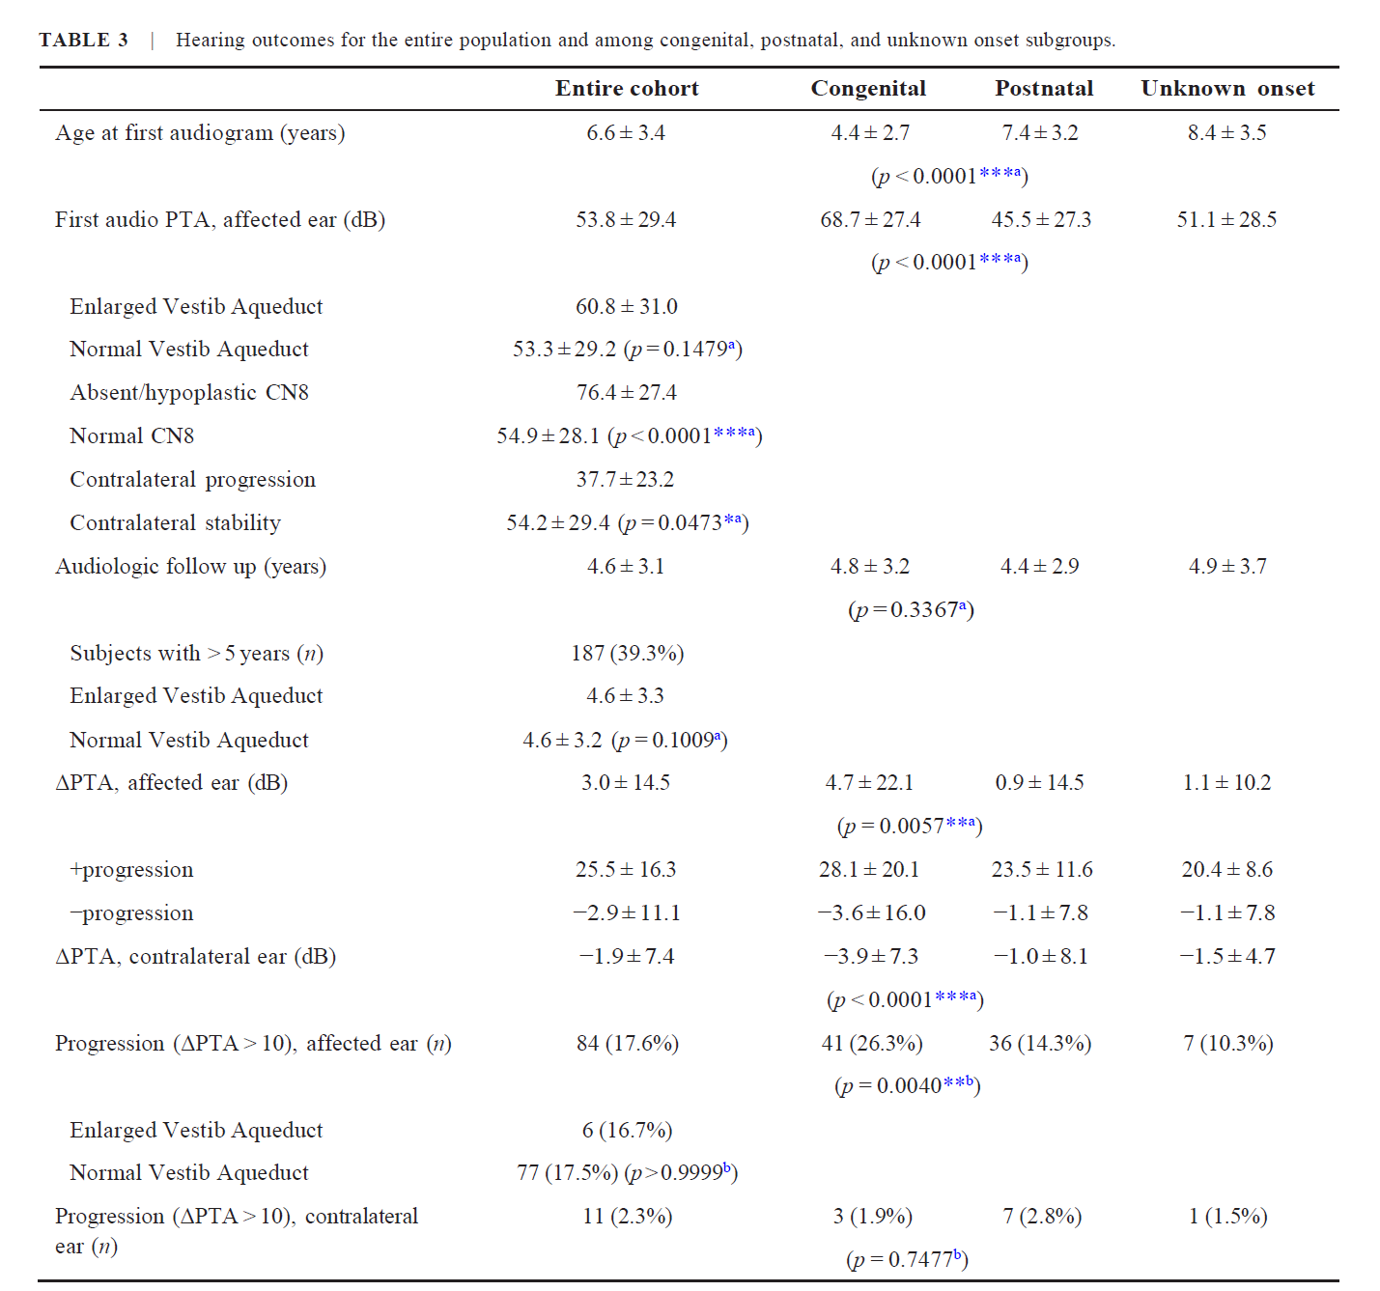

Slide 13
Imaging Findings
Dedicated temporal bone imaging was performed in 296 patients (62.2%): 35.5% had CT only (n = 105), 58.4% had MRI only (n = 172), 6.4% had both CT and MRI (n = 19), and 128 patients (30.0%) had at least one abnormality ipsilateral to the hearing loss.

Slide 14
CT versus MRI
Among the CTs, 26.6% showed an abnormality on the same side as the hearing loss, and 12.1% showed a contralateral abnormality.
Enlarged vestibular aqueduct (EVA) was the most common CT abnormality: 14.5% (n = 18) ipsilateral and 4.0% (n = 5) contralateral.
Ipsilateral/contralateral ears also showed abnormalities in cochlea (8.9% n = 11, 4.0% n = 5), vestibules (4.8% n = 6, 0.8% n = 1), semicircular canals (SCC) (4.0% n = 5, 2.4% n = 3), internal auditory canals (narrowed: 0.8% n = 1, 0.8% n = 1; enlarged: 0.8% n = 1, 0.8% n = 1), or other structures (4.8% n = 6, 1.6% n = 2).
For MRIs, 39.6% identified an abnormality ipsilaterally and 6.8% contralaterally. The most common MRI finding in the affected ear was absent/hypoplastic cochlear nerve in 20.4% (n = 39). Contralaterally, this was 1.0% (n = 2).
Other abnormalities on MRI in the ipsilateral and contralateral ears included EVA (9.9% n = 19, 2.6% n = 5), cochlear anomalies (3.1% n = 6, 0.0% n = 0), SCC (2.6% n = 5, 0.0% n = 0), vestibules (1.6% n = 3, 0.0% n = 0), inferior vestibular nerves (0.5% n = 1, 0.0% n = 0), and other structures (7.9% n = 15, 0.0% n = 0).
Nineteen patients had both CT and MRI; five had abnormalities (three on CT and four on MRI). One patient had EVA on both CT and MRI; in the other four patients, CT/MRI findings did not overlap.

Slide 15
Imaging in Patients With Progressive Hearing Loss
Of the 84 patients with progressive hearing loss in the affected ear, 55 (65.5%) underwent imaging, similar to those with stable hearing (61.7%, n = 242).
CT was performed in 29 (34.5%), MRI in 30 (35.7%).
Those with progressive hearing loss showed a similar range of imaging abnormalities in the affected ear as those without progression.
EVA’s role: 16.7% of patients with EVA had progression vs 17.5% with normal vestibular aqueducts (p > 0.9999, Fisher’s exact). Follow-up duration was similar (4.61 ± 3.30 vs 4.55 ± 3.17 years).
Among 11 patients who developed hearing loss in the contralateral ear, 5 had MRI (one also had CT). Two of these had EVA in the contralateral ear; the remaining three had normal vestibular aqueducts. No other imaging abnormalities were identified in this group.

Slide 16
Imaging Related to Degree of Initial Hearing Loss
The initial hearing loss in the affected ear (first audiogram) was significantly greater in patients with abnormal imaging findings (PTA 64.7 ± 29.0 dB) than in those without (PTA 54.7 ± 28.5 dB, p = 0.0070, Mann–Whitney).
Subgroup analysis: patients with absent/hypoplastic cochlear nerves (n = 39) had initial PTAs of 76.4 ± 27.4 dB, which is significantly worse than patients with normal nerves (n = 153, 54.9 ± 28.1 dB, p < 0.0001, Mann–Whitney).
There was no significant difference in hearing between patients with and without EVAs or other cochlear, vestibular, or SCC anomalies.

Slide 17
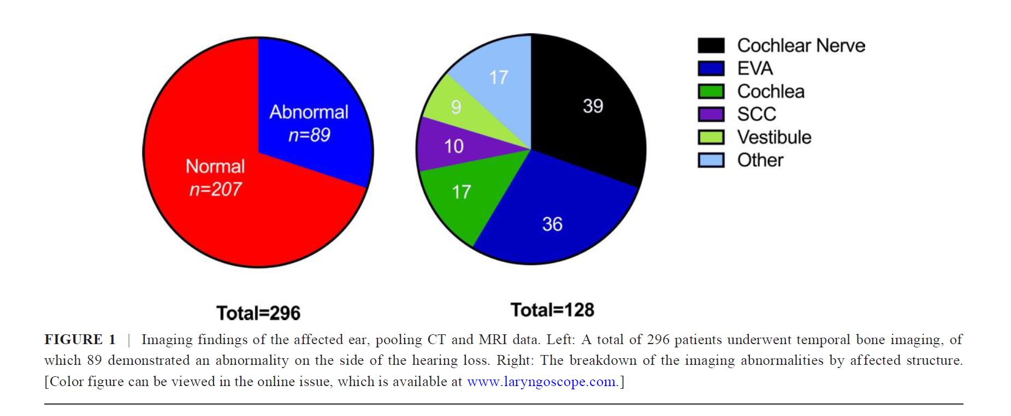

Slide 18
Hearing Rehabilitation
Hearing aid prescriptions
  Prescribed in 80.7% of subjects (n = 384)
Use at last audiology visit
  Full-time: 34.5% (n = 164)
  Part-time: 16.2% (n = 77)
  Inconsistent: 14.9% (n = 77)
  Never: 7.6% (n = 36)
  Unknown: 26.9% (n = 128)
Compliance and insurance
  Compliance at last visit did not correlate with last PTA
  No significant difference by insurance status
Cochlear implants
  Recommended for 9 patients; implanted in 3

Slide 19
Genetic Testing
Testing scope
  54 genetic tests performed in 44 patients
  OtoSCOPE (>200 genes) used in 11 patients ; Two-variant cases: WFS1 and DSPP nonsense variants
Key findings
  GJB2 testing (Connexin 26) performed in 12 patients; no variants found
  31 other tests identified 8 variants diagnosing Lenox-Gastaut, Ehlers-Danlos, Fragile X, Neurofibromatosis-1, and Septo-Optic Dysplasia
Clinical takeaway
  No patients with genetic mutations developed contralateral hearing loss

Slide 20
Discussion

Slide 21
Key limitations:
  Most data collected before routine CMV testing, limiting group comparisons.
  Onset delineation based on NBHS; real-world relevance for anticipatory guidance but potential grouping biases.
  Single-institution design, limiting generalizability and possibly biasing toward better access to care.
Follow-up: Average duration ~5 years.
Implications for interpretation:
  Findings may overestimate or underestimate progression due to pre-CMV era data.
  NBHS-based onset classification remains clinically useful for counseling, despite limitations.

Slide 22
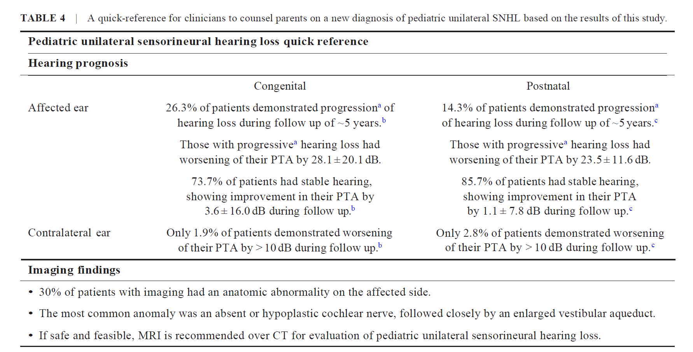

Slide 23
Cohort-wide age at first audiogram: 6.6 ± 3.4 years ( skewed by postnatal and unknown-onset groups; unknown-onset: 8.4 ± 3.5 years).
Congenital group: average first ear-specific audiogram at 4.4 years.
Data reliability: PTA calculated only when ear-specific testing and sufficient frequencies were available; first audiograms often lacked these.
Baseline hearing: overall moderate loss at first audiogram (PTA 53.8 ± 29.4 dB).
Onset differences at first audiogram:
  Congenital onset: 17.0 dB poorer than postnatal onset.
Progression risk:
  Congenital onset: 30% show progression in the affected ear.
  Postnatal onset: 15% show progression.
  Overall progression rate: 17.6% across all patients.
Key finding: Congenital onset associated with higher likelihood of progression; no other clinical factors or imaging patterns predicted progression.

Slide 24
Hearing trend in affected ear: Improvement at midpoint, then decline by the last audiogram; first and last audiograms end with similar PTAs.
Why midpoint improvement: Better cooperation with ear-specific testing leading to a lower measured PTA at mid-timepoint.
Implication: Initial audiogram may underestimate true hearing; long-term outcomes often resemble the first audiogram.
Group differences in PTA change:
  Congenital onset: Increase in PTA 4.7 ± 22.1 dB.
  Postnatal onset: Increase in PTA 0.9 ± 15.4 dB.
  The difference is statistically significant but not clinically meaningful.
Interpretation of difference: Postnatal group had older initial testing age, likely less need for acclimation over time, contributing to smaller PTA change.

Slide 25
Contralateral ear outcomes:
  Normal-hearing contralateral ear progression: rare; only 2% had >10 dB change from first to last audiogram.
  Early prognosis: patients who developed contralateral loss had milder initial loss in the affected ear, suggesting profound initial loss may predict stable contralateral hearing.
  Possible explanation: unilateral absent or hypoplastic cochlear nerve with profound affected-ear loss and no contralateral progression if the contralateral nerve is normal.
Group comparisons:
  No difference in contralateral progression between congenital vs. postnatal onset.
  No specific imaging finding reliably predicted contralateral progression.
Genetic testing:
  Infrequent; underlying mutations could not be ruled out.
Context with other studies:
  Uwiera et al. reported contralateral SNHL in 10.6% of unilateral SNHL, higher than this study, likely because they excluded EVA cases.

Slide 26
Imaging indications:
  Imaging is recommended for pediatric congenital SNHL.
  In this study, ~30% of temporal bone imaging showed an abnormality on the affected side.
Modality findings:
  MRI detected more abnormalities than CT, likely due to higher detection of absent/hypoplastic cochlear nerves (CNs), which CT cannot reliably identify.
  Excluding EVA: absent/hypoplastic cochlear nerves observed in 15% of imaged subjects.
Comparisons to other studies:
  Uwiera et al. (CT-only, EVA excluded) reported only 1% absent/hypoplastic CNs, suggesting potential underestimation without MRI data.
Clinical correlations:
  Imaging abnormalities associated with significantly poorer hearing at the first audiogram.
Practical implications:
  Absent/hypoplastic CNs have implications for cochlear implant candidacy and planning.
  MRI is preferred over CT for unilateral SNHL, especially in severe cases or when cochlear nerve status influences management.
Recommendations:
  Favor MRI over CT for unilateral SNHL work ups to improve diagnostic accuracy and inform implant decisions.
  Weigh MRI costs and sedation risks against the potential benefits of precise CN assessment.

Slide 27
EVA progression concept: Hearing loss related to enlarged vestibular aqueduct (EVA) is traditionally viewed as progressing in a stepwise fashion, often linked to head trauma or barotrauma.
Study finding: In this cohort, 36 patients with EVA did not show an increased rate of hearing loss progression compared with patients with imaging-confirmed normal vestibular aqueducts.
Limitations:
  Small EVA sample size (n=36).
  Average follow-up < 5 years.
  Lack of data on head trauma or barotrauma events.
Implications: EVA status did not predict higher progression in this study; longer follow-up and detailed trauma data are needed to clarify risk.

Slide 28
Genetic testing approach: Recommended for selected patients after geneticist evaluation; mix of congenital and postnatal cases tested.
Findings and limitations: Variants were uncommon; conclusions limited by lack of systematic testing.
Context: Uwiera et al. found no GJB2 mutations; other studies report causative mutations in 20–30% of congenital unilateral SNHL.

Slide 29
Hearing aid use:
  ~80% of patients were prescribed hearing aids.
  About half of these users wore them at least part-time.
Compliance context:
  Lower adherence than some reports; possible reasons: inclusion of unilateral mixed/conductive/SNHL cases in other studies or broad variability in hearing loss.
Impact and recommendation:
  Hearing devices improve quality of life and listening difficulty scores.
  Continue to encourage fitting and use of hearing aids when appropriate.

Slide 30
Conclusion

Slide 31
Study conclusion: Longitudinal hearing data, imaging findings, and hearing aid use patterns in a large pediatric population with congenital and postnatal unilateral SNHL; highlights differences between subgroups.
Key comparative finding: Congenital onset tends to have more severe initial hearing loss than postnatal onset.
Hearing stabilization and progression:
  Congenital onset: 70% stabilize after the first audiogram; 30% show progression.
  Postnatal onset: 15% show progression.
Contralateral hearing: <2% develop contralateral hearing loss; those who do typically have milder initial loss in the affected ear.
Imaging findings:
  Imaging is high-yield: ~30% have an abnormality on the affected side.
  MRI recommended, especially with severe loss, to evaluate cochlear nerve.
  Absent or hypoplastic cochlear nerves associated with poorer hearing.
  Enlarged vestibular aqueduct (EVA) not associated with increased progression risk vs. non-EVA.

Slide 32
THANK YOU
Presentation by Dr. Ahmadzadeh

